Slide 1
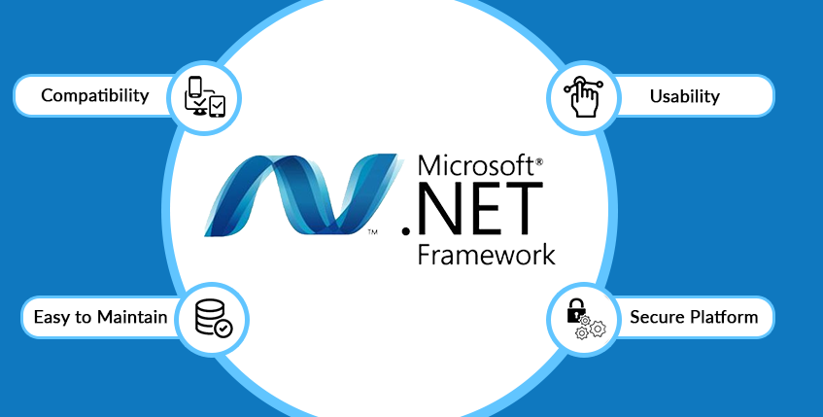
Microsoft .Net Framework

Slide 2

Why use .Net ?
It supports 60+ programming languages such as C#, F#, VB.NET, J#, VC++, JScript and many more.
It makes Application Development easy on Windows, Web and Phone.
It contains a rich set of library know as Framework Class Library (FCL)
It manages the memory, network, security and type-safety.
It supports Garbage Collection.

Slide 3
How does .Net work ?
We write our program in one of the supported programming language framework, after that the compiler for that respective programming language is invoked and translates it into a common intermediate language format. This intermediate representation is passed to the Common Language Runtime and it converts it into native code which is then executed directly by the processor.

Slide 4
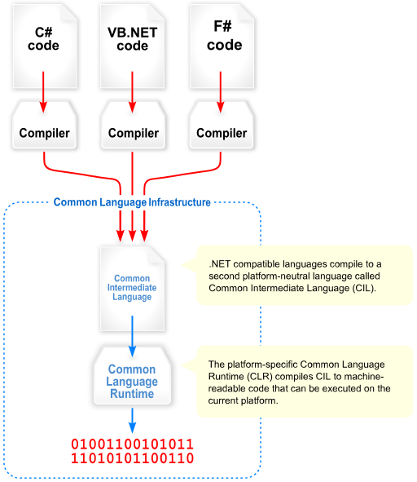

Slide 5
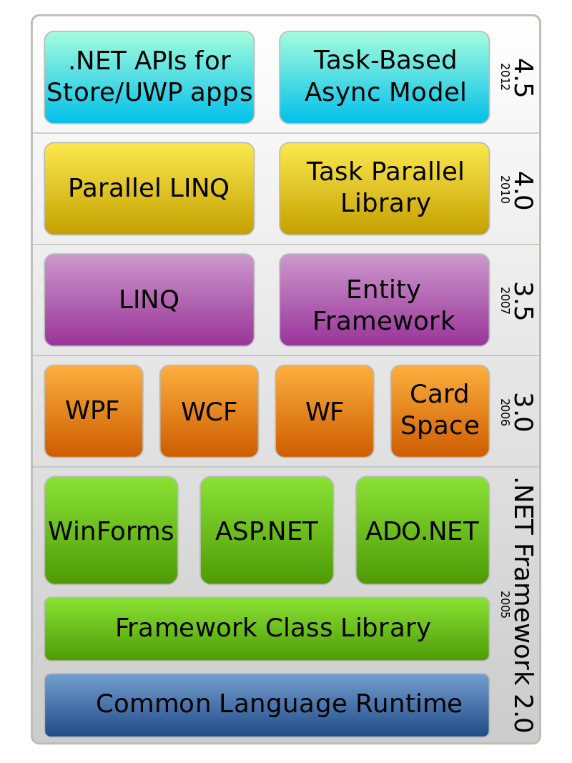
Improvement in .Net over the years

Slide 6
Components of .Net
Common Language Runtime: It takes an intermediate representation and converts it into native code, in the meantime it takes care of type-safety and exception handling as well.
Framework Class Library: It the the standard library of the .Net and the Base Class Library in FCL provides basic functionalities.
WinForms: simplifies common application task such as reading and writing to the filesystem.

Slide 7
Components of .Net
ASP.NET: Provides an integration between HTML, CSS and JavaScript. It is used to develop web apps and web services.
ADO.NET: Establishes a connection between application and data sources such as SQL Server and XML. Simplifies the process of connecting, retrieving, inserting and deletion of data.
Windows Presentation Foundation: Used to render UI in Windows.
Windows Communication Foundation: Used for sending asynchronous messages between services.

Slide 8
Components of .Net
Language Integrated Query: It is a query language through which we can write queries in languages such as C# or Visual Basic to query data sources.
Entity Framework: It is an ORM used to work with databases using .Net objects.

Slide 9
C# (Not C hashtag)
C# is an object oriented programming language developed by Microsoft.
C# is supported by the .Net Framework
90% of .Net applications uses C# as it’s programming language.
C# uses the component oriented programming approach.

Slide 10
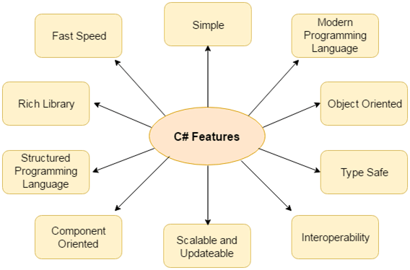
Features of C#
Generics, Partial types, static classes, dynamic binding, optional arguments and much more.

